Slide 1
THE SUPERSTORE SALES ANALYSIS PROJECT

Slide 2
INTRODUCTION
This is a Microsoft Excel project carried out to deliver an end-to-end business intelligence solution for a Global Store. The project was done to create a dynamic and interactive dashboard to enable the organization track KPIs on sales, profit/loss, and profit margin, compare regional performance, analyze product-level trends and forecasts, and identify high-value customers.
OBJECTIVES
We dived into the sales dataset with the objective of extracting revenue metrics, top selling product, trends, and actionable insights that will enable the business optimize their sales strategies and boost revenue growth.
The aim of this project is to derive insights for a company sales from the year 2014 to 2017. The tool used for this project is Microsoft Excel.
Notes:
Objectives

Slide 3
Methods
The dataset was imported into excel using the ‘Get Data’ option and then proceeded to transform the data in power Query.
The dataset was meticulously cleaned by first promoting the header row to ensure accurate column naming, changed the data types, removed duplicates to enhance data integrity.
Using Excel formulas, I created metrics for the mean, median and standard deviation for sales, quantities, discount and profit.
The visuals were created using the pivot tables for the monthly sales trend, the top 5 sales by sub-category of products, the sales and profit by region, top customers segment.
The report consists of 2 pages Dashboard and visualizations used to display KPIs, bar charts, line charts, table, maps to analyze sales across different regions.

Slide 4
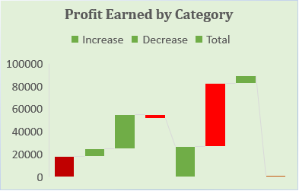
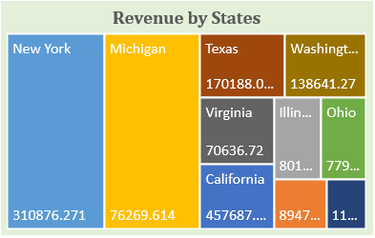
SUPERSTORE SALES ANALYSIS DASHBOARD
2296919.488
Total Profit
Quantity Sold
Total Order Sold
Total Sales
286409.0805
12%
37
38717
Profit Margin
9993

Slide 5
SALES DASHBOARD 2

Slide 6
INSIGHTS
Over a 5 months period (January to May),the highest sales were achieved in March after which there is a relatively constant sales of 50,000 from April to August. The highest sales of 350,000 was in November and highest profit of 45,000 was made in December. Sales improved during the festive season.
From the category of the 3 products sold, the technology products has highest sales of 836154.033 (36%)
While from the sub-category of products, the top revenue generating products are phones and chairs with a peak sales of 330,007.054 and 328,167.731 respectively.
The highest sales were made by consumers with a value of 1,161,401.345 followed by corporate with a value of 706,146.3668 and home office has 429,371.7765.
The top contributing region is the west (725,457.83), followed by East (678,499.87). The Central has the least sales of 39,706.36 and South (46,749.43).
The state with the highest sales is California 457,687.6315 and the lowest is Virginia with sales of 70,636.72.

Slide 7
RECOMMENDATIONS
Optimize advertisements for products with low sales by highlighting their functionalities and benefits.
Given that March had the highest sales, further analysis should be done to know what factors contributed to the success and implement strategies to replicate or improve upon it in other months.
Implement discounts on low selling products during the company’s peak season to maximize sales.
Carry out market research in cities with low patronage and make plans with the result of the research to improve sales.
Boosting sales during the slow months by implementing promotions, discounts or special offers.
Address the significant loss in the "Tables" sub-category. Explore cost saving measures or evaluate the product's pricing and marketing strategy to mitigate losses.

